Slide 1
AGRICULTURE PRODUCT MANAGEMENT SYSTEM (APMS)
Submitted by : Rakesh Tamang & Sagar Magar

Slide 2
INTRODUCTION
APMS is an auction site web based platform which helps farmer to improve their profitability.
It enables farmers to sell/bids their products through online without the middle-man directly to the consumer.
This platform will try to eliminate the need of the middle-man between the seller and the buyer.

Slide 3
There are three kinds of users for the proposed system.
Administrators
Sellers
Customer

Slide 4
1. Administrators
Administrators are the one who has full privilege of the websites.
2. Sellers
Sellers are the farmers and they can sell their products through online after the registration. After registration the farmer can login into the system by entering login id and password.
3. Customer
Customers can buy products through online.

Slide 5
Problem Statement
The problem that occurs in APMS is buyer cannot evaluate the product physically.
Interaction between buyer and seller may be not proper due to online.

Slide 6
OBJECTIVES
Developing Agriculture management system to help to improve the profitability.
The farmers can sell their products through online and customer can buy directly.
To provide the wider market opportunity to the farmer so, that they can sell their product at right time.

Slide 7
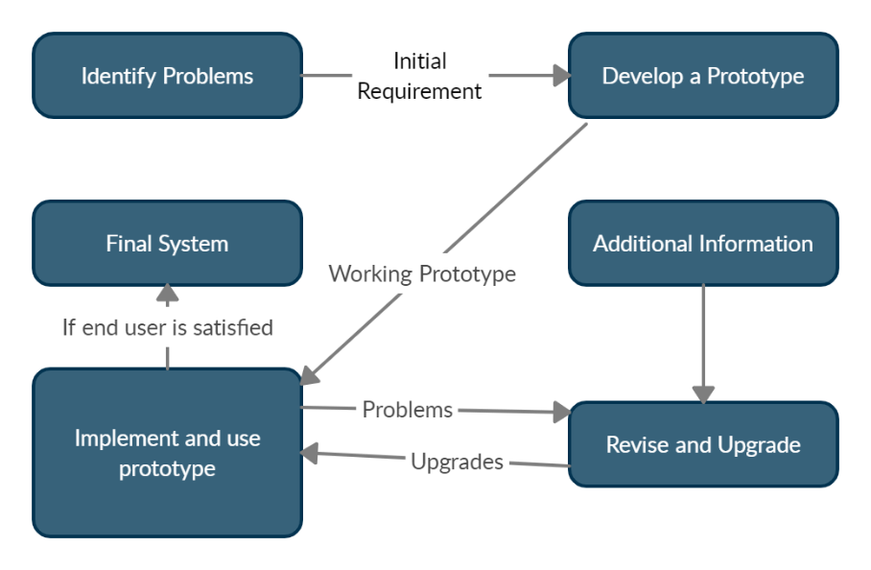
METHODOLOGY
After analyzing all the available data models we found out that prototyping will be suitable for our project as we aim in achieving the best possible interface and interaction.
PROTOTYPE MODEL

Slide 8
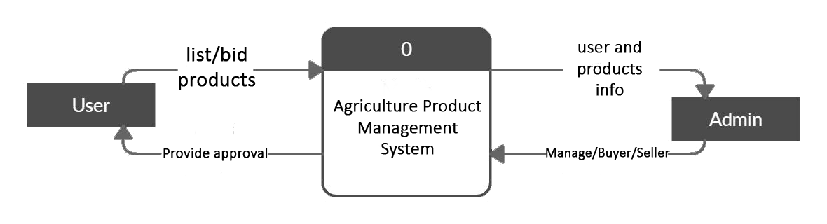
Fig : 0/Context diagram

Slide 9
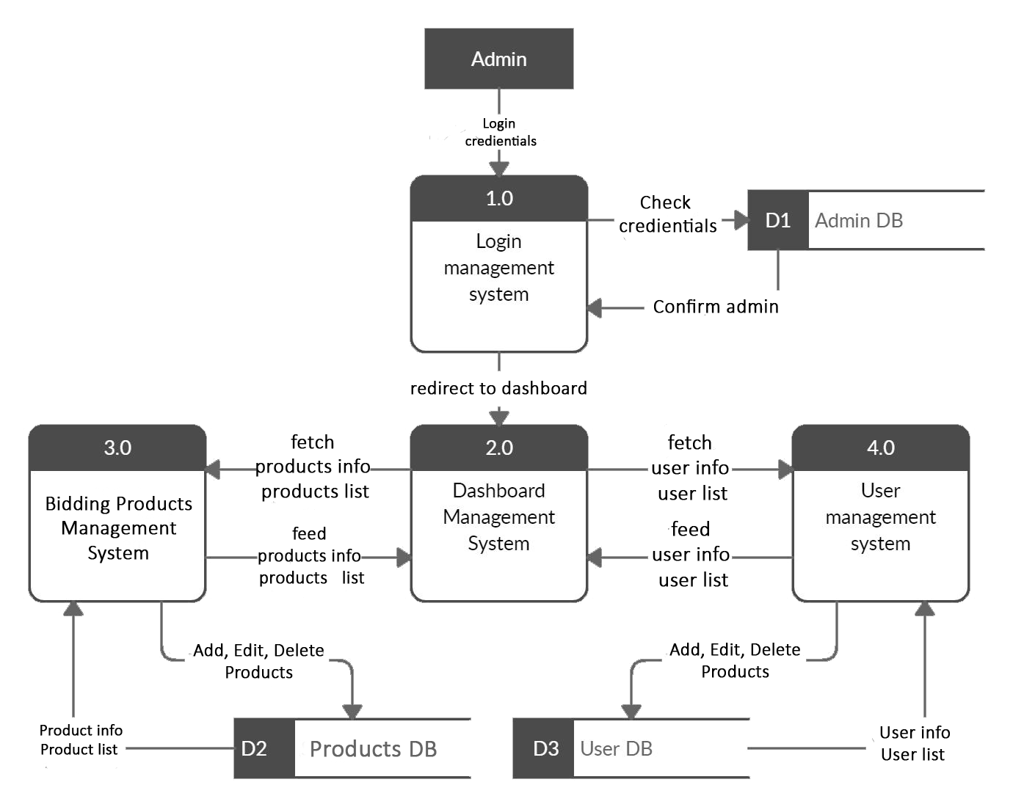
Fig : DFD of Admin

Slide 10
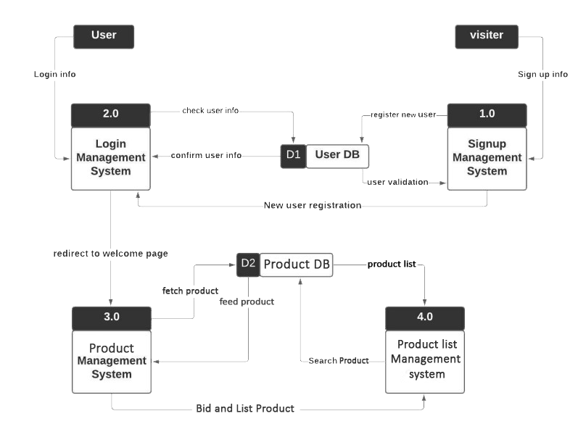
Fig : DFD of User

Slide 11
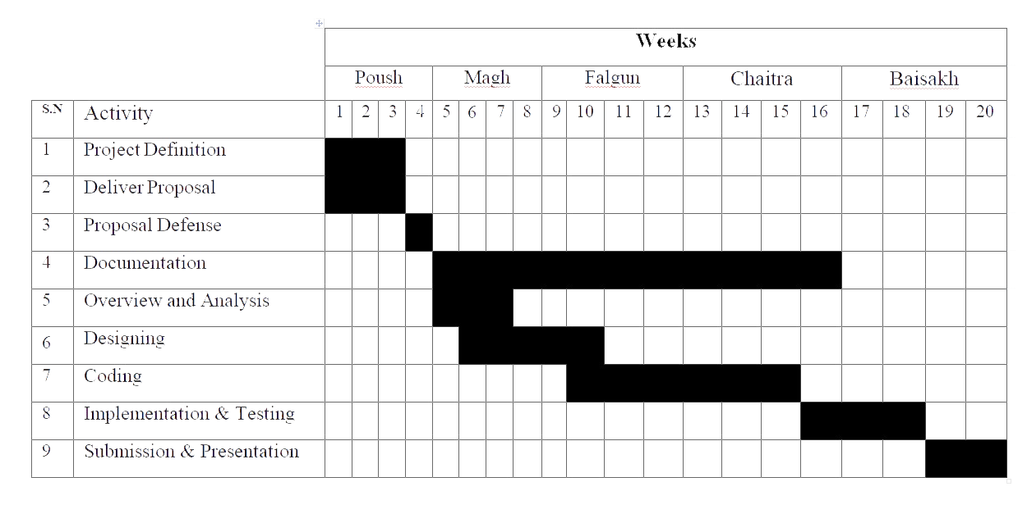
Fig : Gantt Chart

Slide 12
THANK YOU

